Slide 1

Collections - Capability
Data Products and Platforms – BIIS
March 2016

Slide 2
Overview
Broad Level Problem Statement
Optimizing the contact strategy to reduce the costs with minimal impact on payments collected from the customers
Customer Journey and Demographic Data Marts : Data Marts created by extracting data from different data sources into Hadoop.
These Data Marts are then used for analysis and generating insights.
Insights Overview
Optimizing the costs on the contact channel with the focus on dialer reduction/elimination
Insights | Recommendation | Potential Benefit
Reducing contact frequency for Customers who are ‘Hard to Reach’ by a specific contact channel | Dial only once a month for the specified segment of customers | £1.15M Savings
Identifying the optimal Cut-Off Point for Dialer based on Payment and Response behavior of the customers | Stop dialing the customer after 20 successive unsuccessful dial attempts | £ 990k Savings

Slide 3







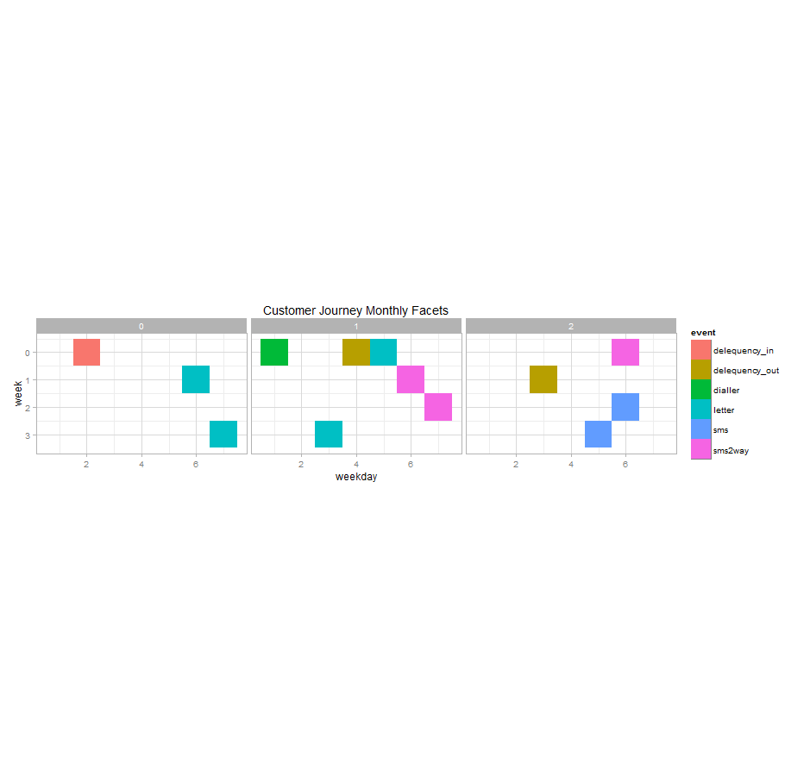
Customer Journey and Demographic Data Marts
Debt
Manager
Impala
Data is extracted from 8 different data sources(including APS,IVM , Genesys, Triumph and Debt Manager) and an aggregated data mart is created(for table structure refer Appendix). Demographic data mart is created with limited information available in Debt Manager about customer(table structure in appendix).
APS
Customer Journey Data Mart
Triumph
Hadoop
Demographic Data Mart
Genesys
CMC
Customer journey is created from a point where he enters delinquency till a payment or an RPC or delinquency out after sorting by date((which ever comes first in the data). Chart beside depicts customer journey with one such path for a customer.

Slide 4
Business significance of the various score
Hard To Reach
Proposed Test
Certain customers have high bounce rates for specific channels. Reducing the frequency of contact for that channel to these customers would result in cost saving with lower impact on recovery.
Calculate ‘hard to reach rate’ by taking ratio of number of undelivered contacts to total contacts
Customers with few attempts need to be treated differently hence ‘Hard to Reach Score’ is calculated by multiplying this number by a confidence factor. This confidence factor increase with number of total contacts.
Customer ID | 2waysSMS | Dialer | Email | 1waySMS
114 | 45 | 100 | 50 | 99
124 | 0 | 50 | 21 | 21
314 | 98 | 79 | 50 | 50
514 | 50 | 70 | 40 | 3
914 | 50 | 83 | 10 | 50
Dialer Cutoff
Proposed Test
Response from a customer- defined as a customer picking up the phone and having a conversation with the agent(RPC) and/or the customer making a payment
Generated the customer Journey- Starting from when the customer enters delinquency to the first time there is a response. A new is started after there is a response
Identified the optimal point of cut-off after which the dialer can be eliminated for the customer
After certain number of successive failed dial attempts to the customer, the chances of successful contact reduces significantly and hence eliminating the dialer attempt after the optimal point can lead to direct cost savings Results.

Slide 5
Use Case – enabled with the score from the previous slide
Hard To Reach
Proposed Test
Channel: Dialer Segment: Customer with “Dialer Hard to Reach Score” of more than 90
Proposed Strategy: Dial on day 25, 1 pass (Avg. 3 Attempts in back test period)
Current Strategy: 0.5 to 3 passes by Predictive Dialer and 1 pass by Manual Dialer (Avg.16 Attempts in back test
Tested on Oct to Dec 2015 data
Results
All numbers are for 3 months period Oct to Dec 2015
42%
29%
17%
£ 238k
Dial Attempts Saved
700K
Dialer Cost Saved
£ 161K
RPCs Missed
11k
Payment at Risk (Payment on day of RPC)
Dialer Cutoff
Proposed Test
Channel: Dialer Segment: Customer who had 20 successive failed attempts
Proposed Strategy: Stop dialing the customer after 20 successive unsuccessful dial attempts
Current Strategy: Dial attempts are continued for the customer even after there are significant unsuccessful dials
Results
Putting a cut off of 20 Dials results in
24%
£ 0.99 mn
2.1%
£ 0.16 mn
Dials Saved
Annual Dialer Cost Saved
RPCs Missed
Payment At Risk Annually (Payment on day of RPC)

Slide 6
Appendix

Slide 7
Table Structure
Customer Journey Data Mart attributes
Field Name | Description
Card Holder Id | Unique customer id for each customer
Account Number | List of all accounts for a customer
Router Number | Unique key identifying customer each time a customers enters collections.
Event | which channel was used to contact the customer eg: SMS,Email,Dial etc
Event Date | Date on which the event occurs
Delinquency Start Date | The date on which the customer comes into Collections.
Delivery_status | whether the contact was successfully made.
Delivery Date | date of event delivery.
Delivery_code | response description
cycle | the delinquency cycle the customer is in currently(between 1-7).
Payment amount | the exact payment made when contacted by an channel on a given date.
Event order | the order in which the events happened if on the same day.
CGU outcome | Flag indicating CGU or not
Cost per event | cost associated with the event(eg : per dial costs 4 pounds, SMS costs 4 cents etc)
Demographic Data Mart attributes
Field Name | Description
Card Holder Id | Unique customer id for each customer
Profile Date | Monthly Date (corresponds to the end of month date for the entire two year period)
age | Age of the customer
gender | Gender flag
married | Marital status
employed | Employment status

Slide 8
Thank You

